Slide 1
TEXT ANALYZER

Slide 2
Team members
KASANUR JYOTHIRADHITHYA (RA2011003010416)
YESWANTH J B (RA2011003010432)

Slide 3
Introduction
A text analyzer is a software tool or program that is designed to analyze and provide insights on various aspects of written text. It analyzes text and provide a range of outputs, including sentiment analysis, keyword extraction, and text classification. The results of text analysis can be used to gain insights into a variety of areas, including customer feedback, social media trends, product reviews, and more. Text analyzers can be useful for businesses, researchers, journalists, and individuals who want to better understand and analyze written text.

Slide 4
PROBLEM STATEMENT
Text Analyzer will analyze the text that has been entered and provides the number of words, sentences, uppercases, lowercases, spaces, digits, vowels and consonants are present in the given text. The text analyzer will provide the insights of the text that has received. By the consonants and vowels we can know about the number of letters are used in the text and which are lowercase and uppercase will also be known. The spaces for each word also be presented.

Slide 5
OBJECTIVES
The objective of a text analyzer that produces the number of words, sentences, uppercase, lowercase, digits, vowels, and consonants of the given text. However, this analyzer provides more detailed information about the text, including information on the presence of digits and vowels. Overall, the objective of this type of text analyzer is to provide detailed information about the text, including information on the presence of numbers and vowels. This information can be useful for understanding the characteristics of the text and can also be used to calculate various metrics and statistics.

Slide 6
METHODOLOGY
Tokenization: The text is first broken down into smaller units called tokens. In this case, the tokens would be words and sentences. This can be done using regular expressions or other tokenization techniques.
Word and sentence counting: The analyzer would then count the number of words and sentences in the text. This can be done by simply counting the number of tokens that have been identified as words or sentences.
Case counting: The analyzer would count the number of uppercase and lowercase letters in the text. This can be done by iterating over each character in the text and checking if it is uppercase or lowercase.
Digit counting: The analyzer would count the number of digits in the text. This can be done by iterating over each character in the text and checking if it is a digit.
Vowel and consonant counting: The analyzer would count the number of vowels and consonants in the text. This can be done by iterating over each character in the text and checking if it is a vowel or consonant.
Output: Finally, the analyzer would output the results of the analysis, including the number of words, sentences, uppercase letters, lowercase letters, digits, vowels, and consonants.

Slide 7
DATA COLLECTION
The data collection for a text analyzer that produces the number of words, sentences, uppercase, lowercase, digits, vowels, and consonants of the given text is simply the input text that is being analyzed. The text is typically provided as a string variable or a file that contains the text.
The data collection process can be manual, where the user enters the text into the analyzer directly. Alternatively, the text can be automatically extracted from a web page or other data source using web scraping techniques or APIs.
It is important to note that the accuracy and reliability of the analysis depends heavily on the quality of the data. If the input text contains errors, misspellings, or other issues, the results of the analysis may be incorrect or misleading. Therefore, it is important to ensure that the input text is clean and accurate before analyzing it.
In summary, the data collection for a text analyzer that produces the number of words, sentences, uppercase, lowercase, digits, vowels, and consonants of the given text is simply the input text that is being analyzed, and the quality of the input text is critical to the accuracy and reliability of the analysis.

Slide 8
REQUIREMENTS
SOFTWARE REQUIREMENTS:
Windows/Operating System
Visual studio
HARDWARE REQUIREMENTS :
Minimum of 4GB RAM

Slide 9
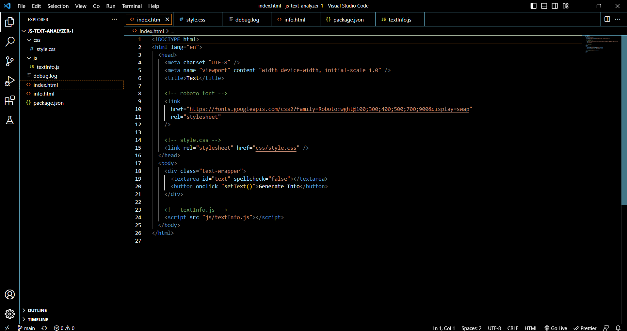
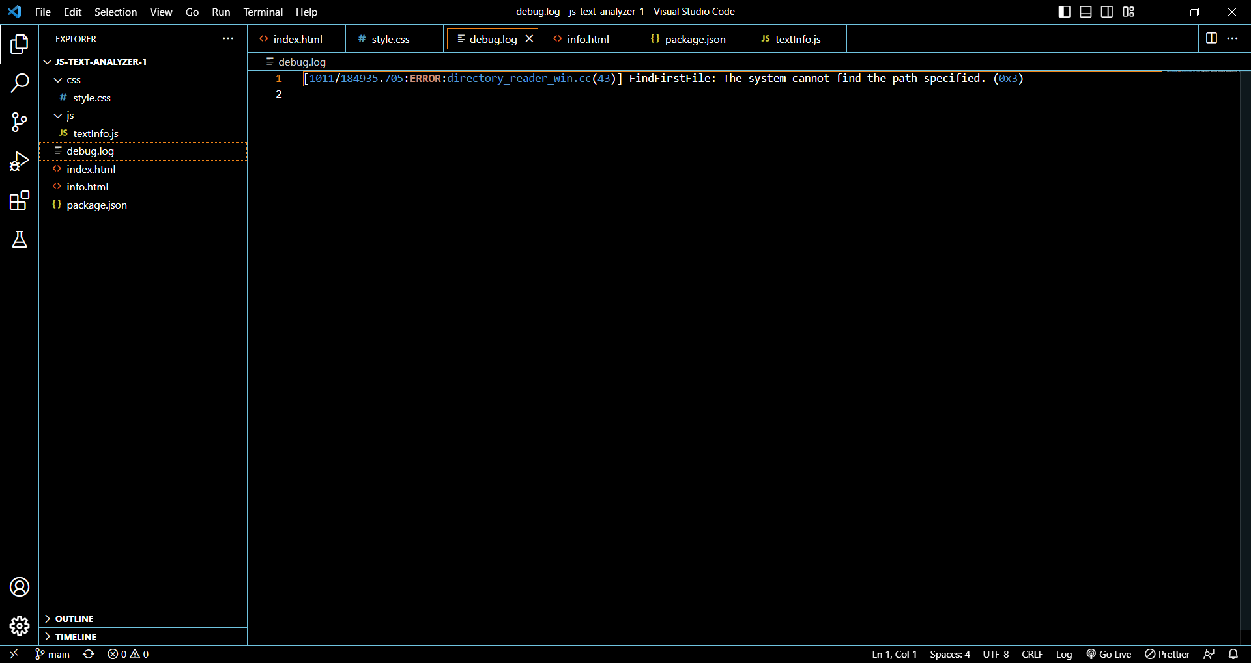
SOURCE CODE

Slide 10
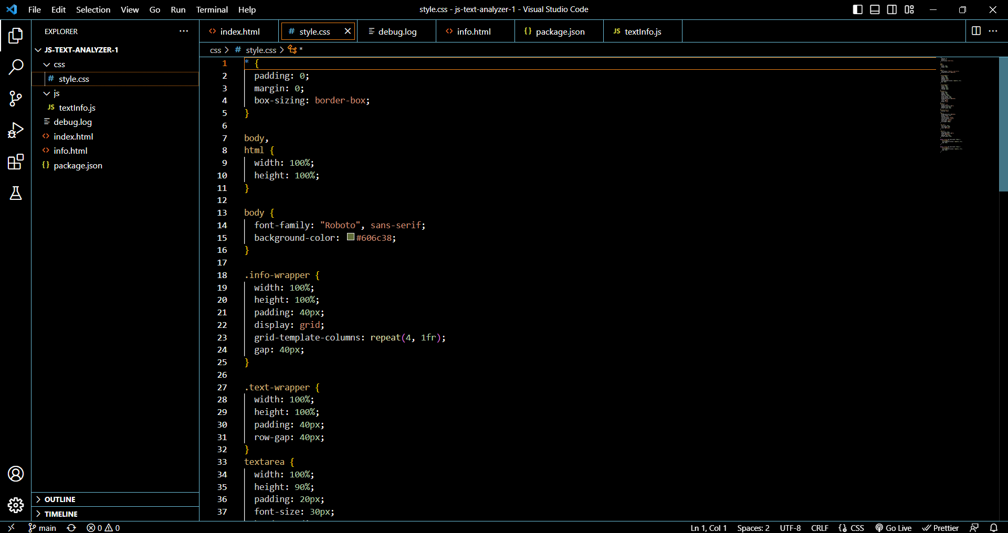
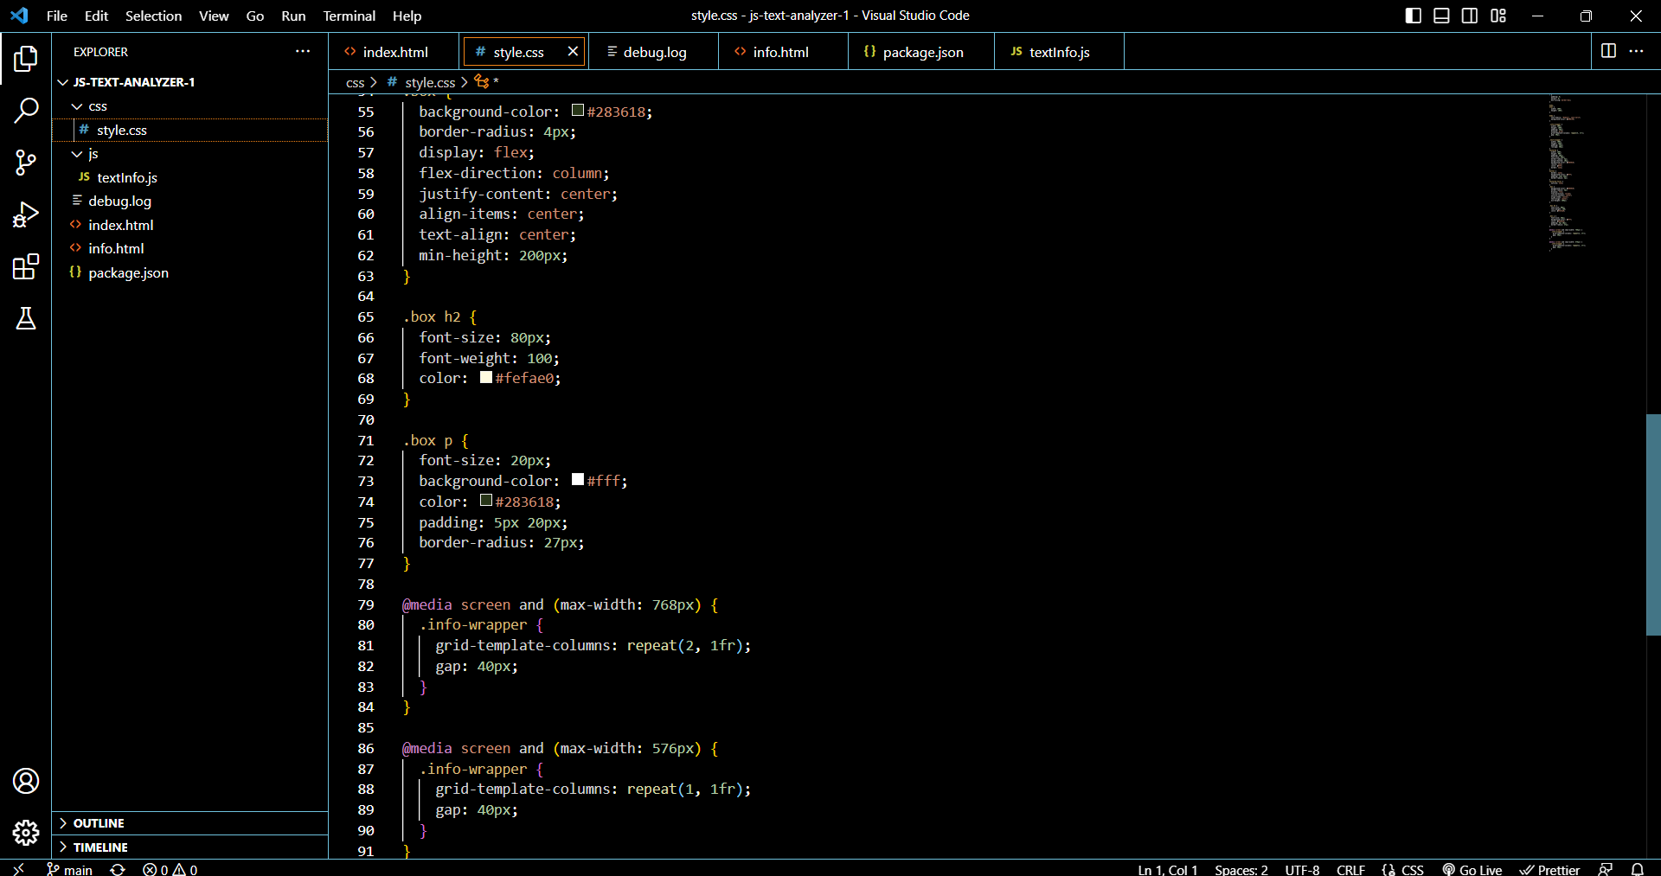
SOURCE CODE

Slide 11
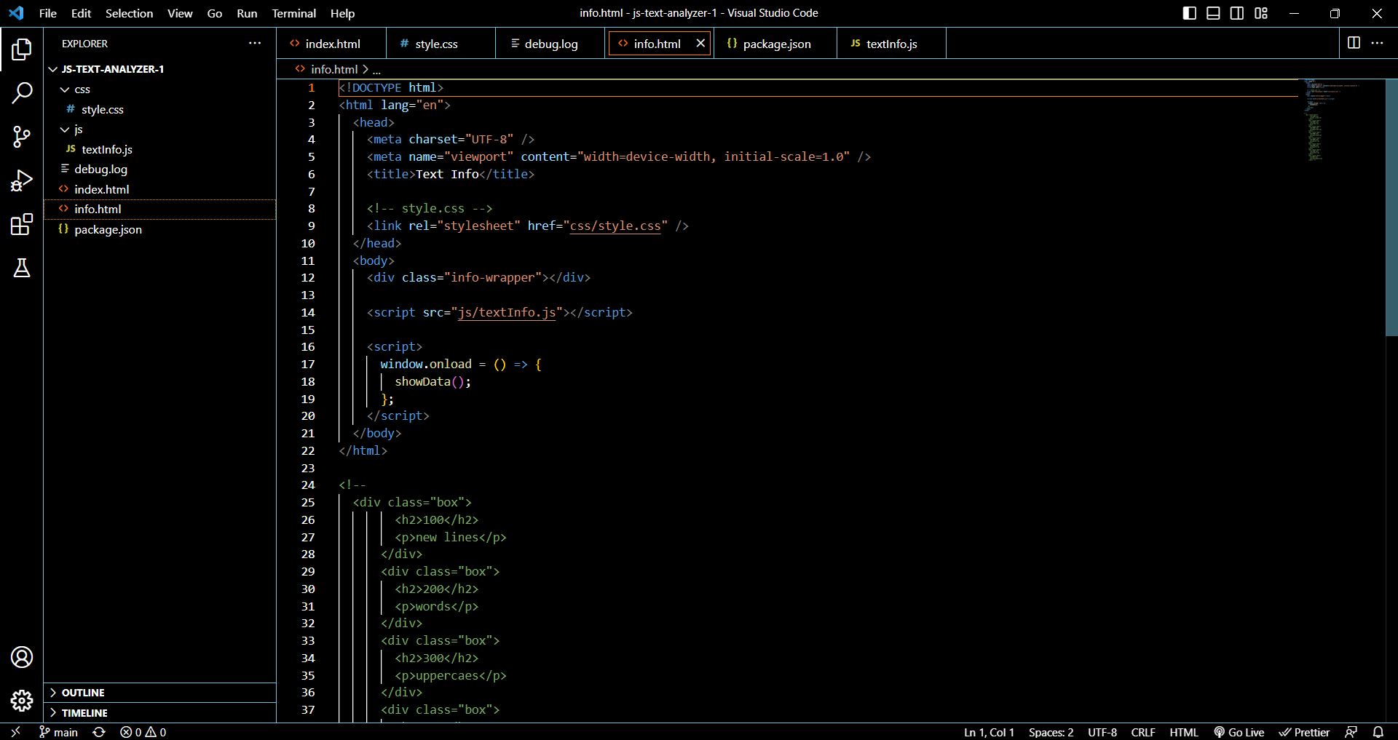
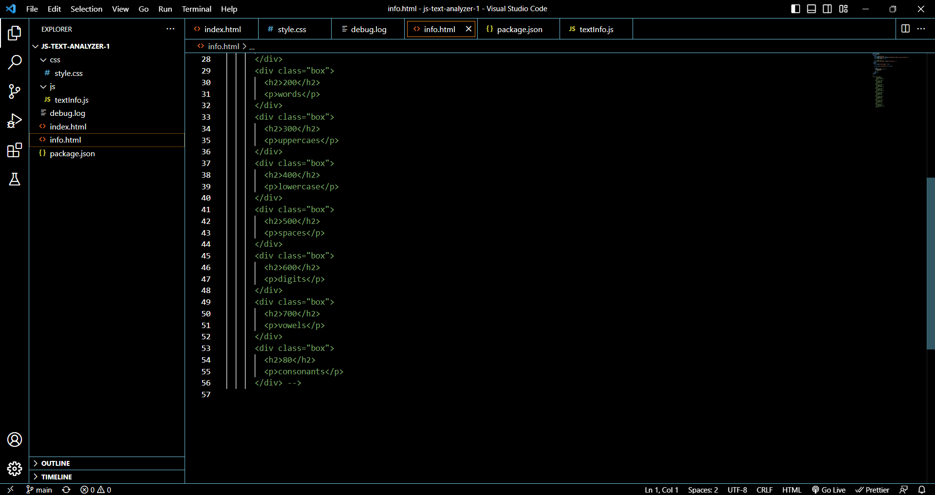
SOURCE CODE

Slide 12
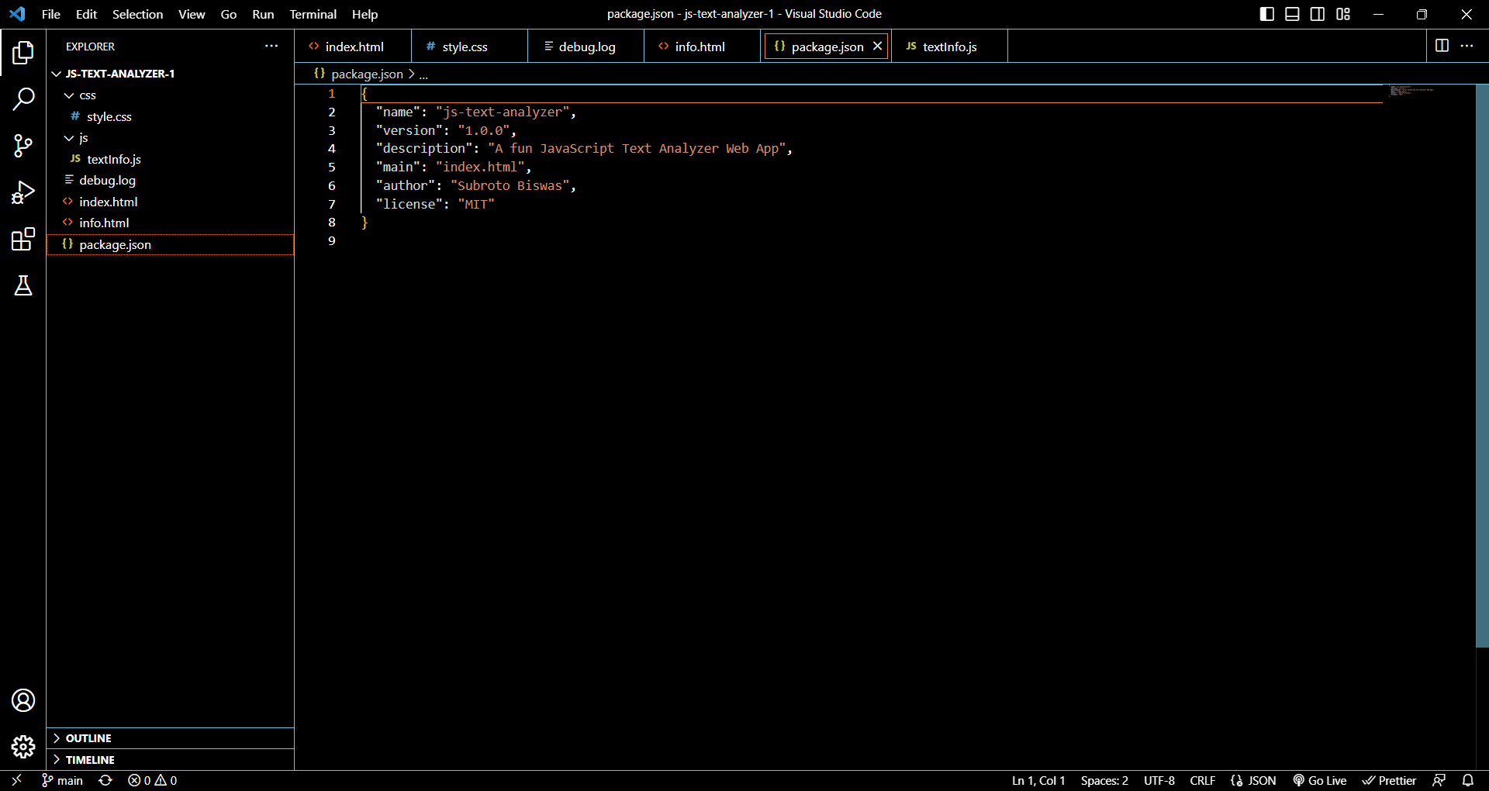
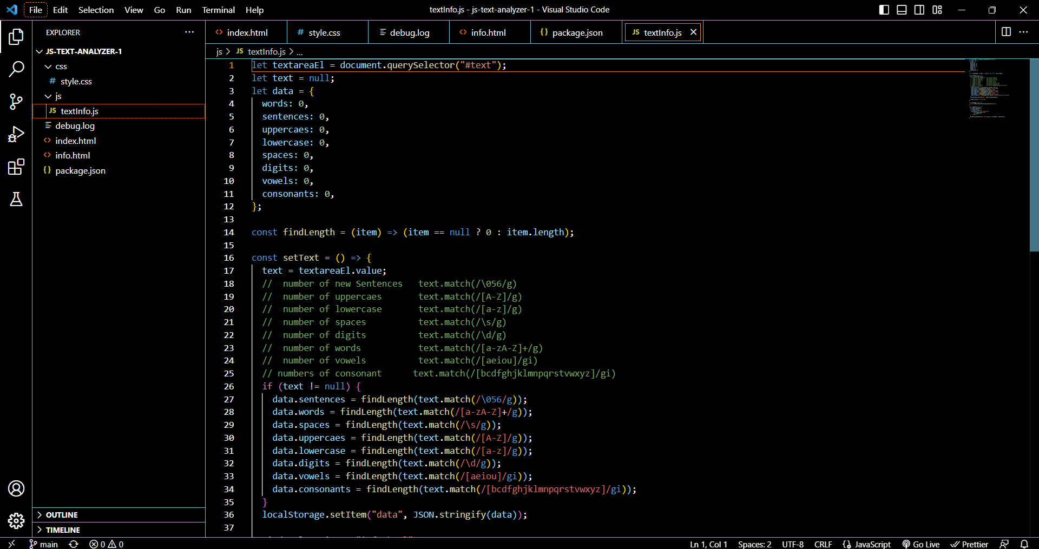
SOURCE CODE

Slide 13

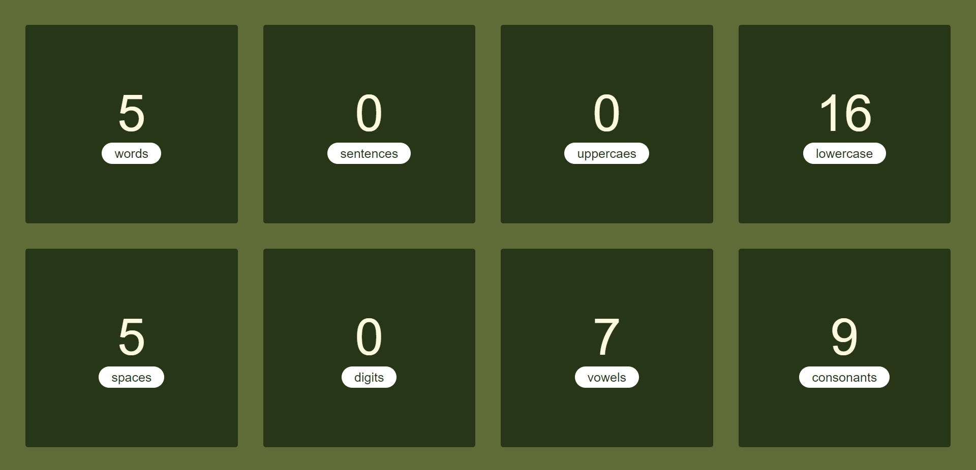
Result

Slide 14
CONCLUSION
The “Text Analyzer” that produces the number of words, sentences, uppercase, lowercase, digits, vowels, and consonants of the given text has proven to be an effective tool for analyzing text and extracting various linguistic features. Through the development and implementation of this project, we have gained a deeper understanding of the underlying principles and techniques of natural language processing, including tokenization, part-of-speech tagging, and feature extraction.

Slide 15
REFERENCES
https://www.usingenglish.com/resources/text-statistics/
https://www.lexicool.com/text_analyzer.asp
https://www.webtools.services/text-analyzer
https://aws.amazon.com/what-is/text-analysis/#:~:text=Text%20analysis%20is%20the%20process,sentiments%2C%20and%20other%20actionable%20knowledge.

Slide 16
Thank you

